Slide 1

Predicting Flight On-Time Performance
Ariffin Sarhid

Slide 2
TABLE OF CONTENTS
01.
04.
Problem Statement
Feature Engineering
02.
05.
Data Cleaning
Model
03.
06.
Data Exploratory
Answering the Problem Statement

Slide 3
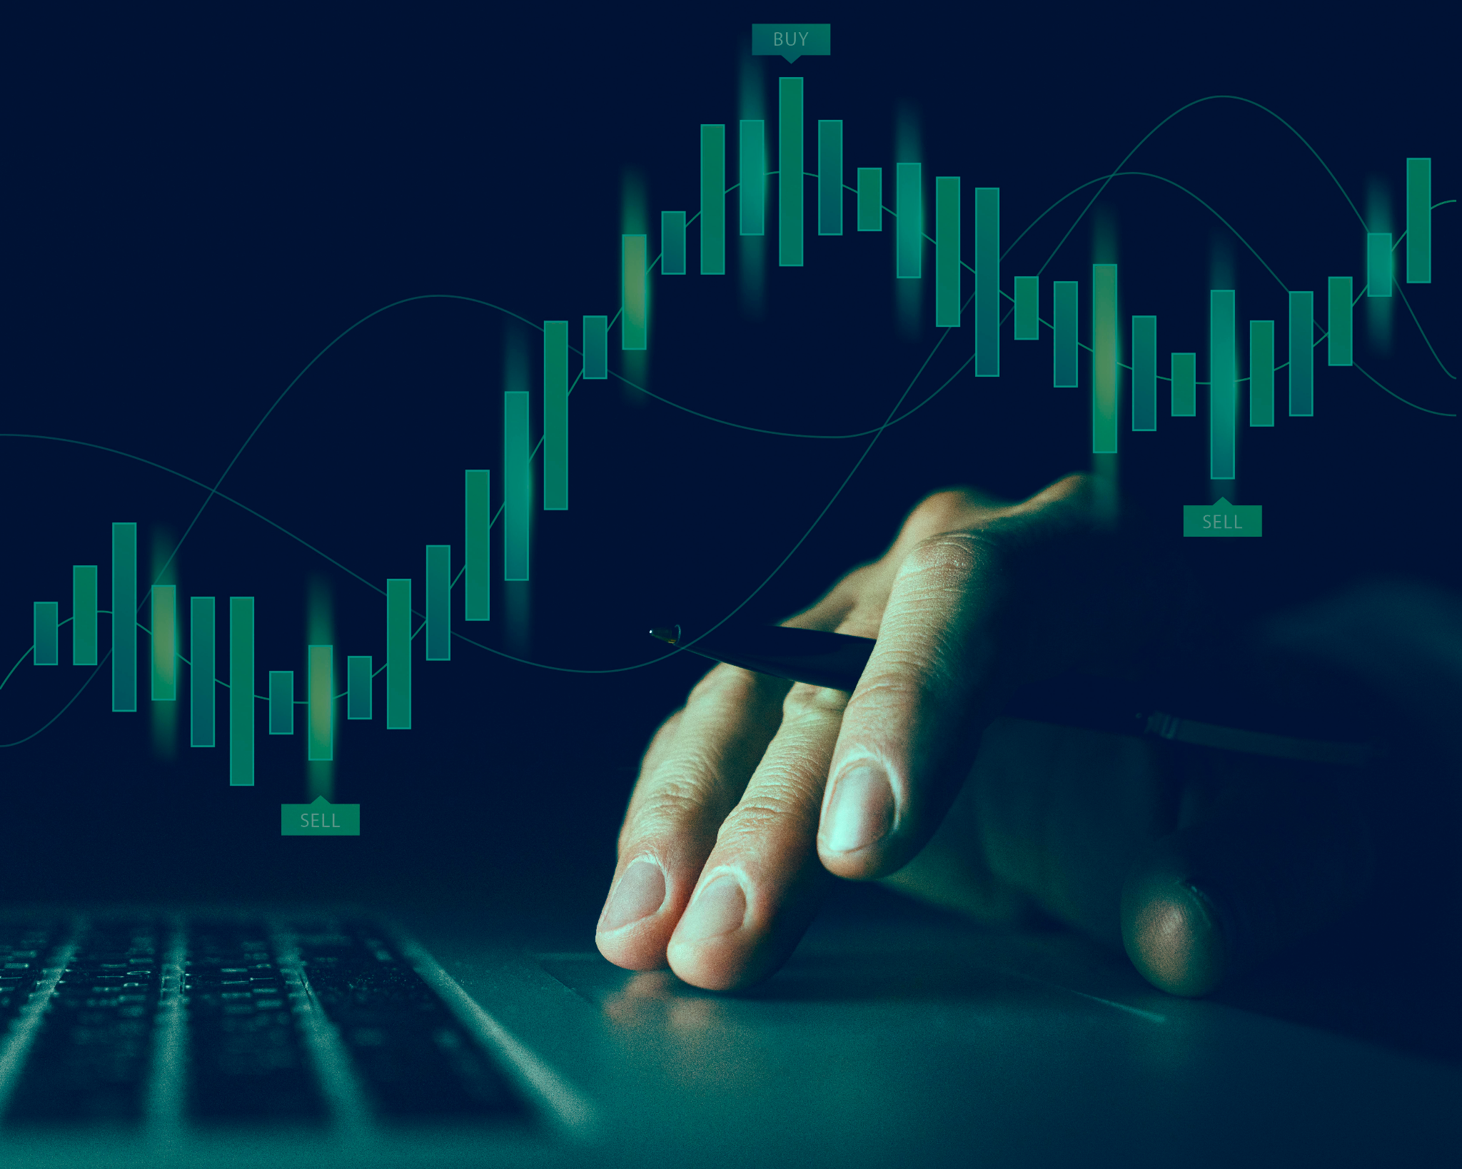
01.
Background & Problem Statement

Slide 4
Background
Flight insurance is designed to protect the cost of your flight. Generally, some of the common problems that are covered in a flight insurance is flight cancellations, unexpected flight delays, or mid flight diversion. Insurance companies usually have difficulty in predicting these events. Having a model to predict the likelihood of these events may help the insurance companies to set a competitive premium for its insurance product.

Slide 5
02.
Data Cleaning

Slide 6
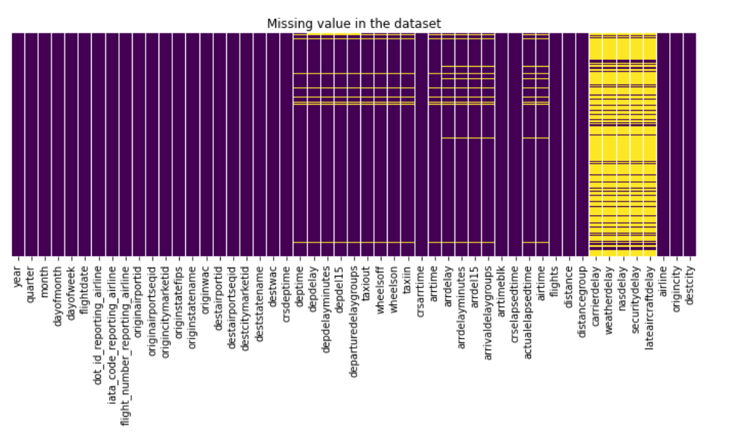
Data Cleaning
2 Datasets
Merged Both Datasets
Null Values
01
02
03
Flight Details – include departure and arrival information
Airline Code Description
Merge Airline Delay dataset and Airline Code Description
2.5% of 89009 rows were drop

Slide 7
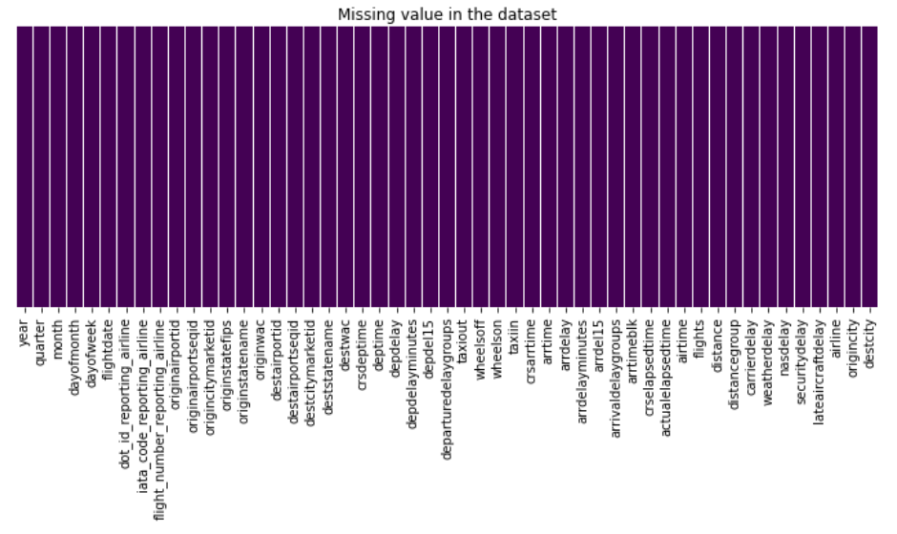
Data Cleaning
Clean Columns
Drop Columns
04
05
Replace ‘ ‘ with ‘_’
Lowercase
Columns with non-unique information were dropped.
df.shape
(86761,51)

Slide 8


Data Exploratory
Images reveal large amounts of data, so remember: use an image instead of a long text. Your audience will appreciate it

Slide 9
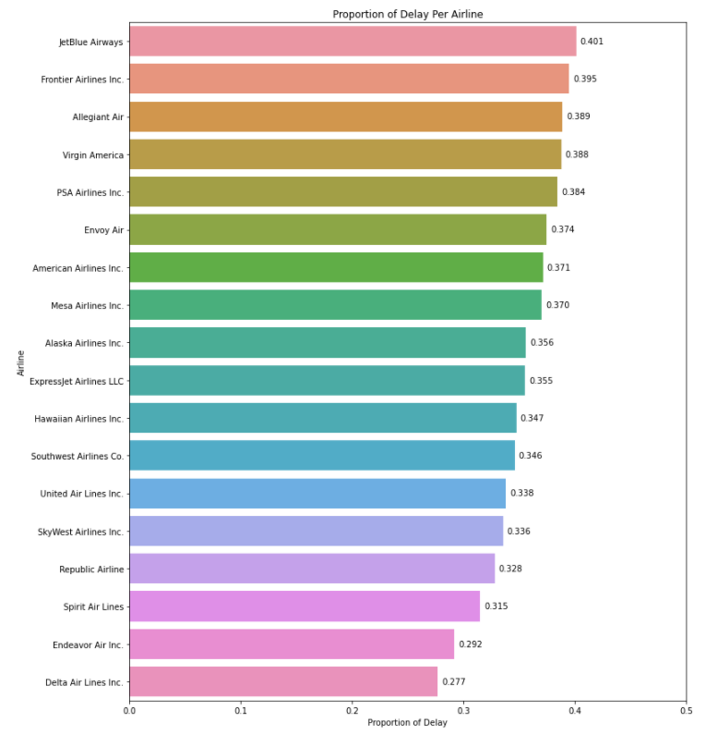
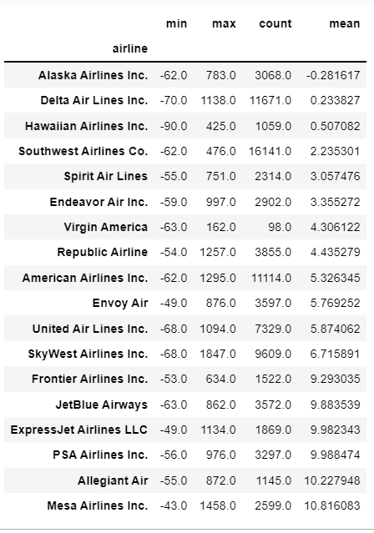

Slide 10
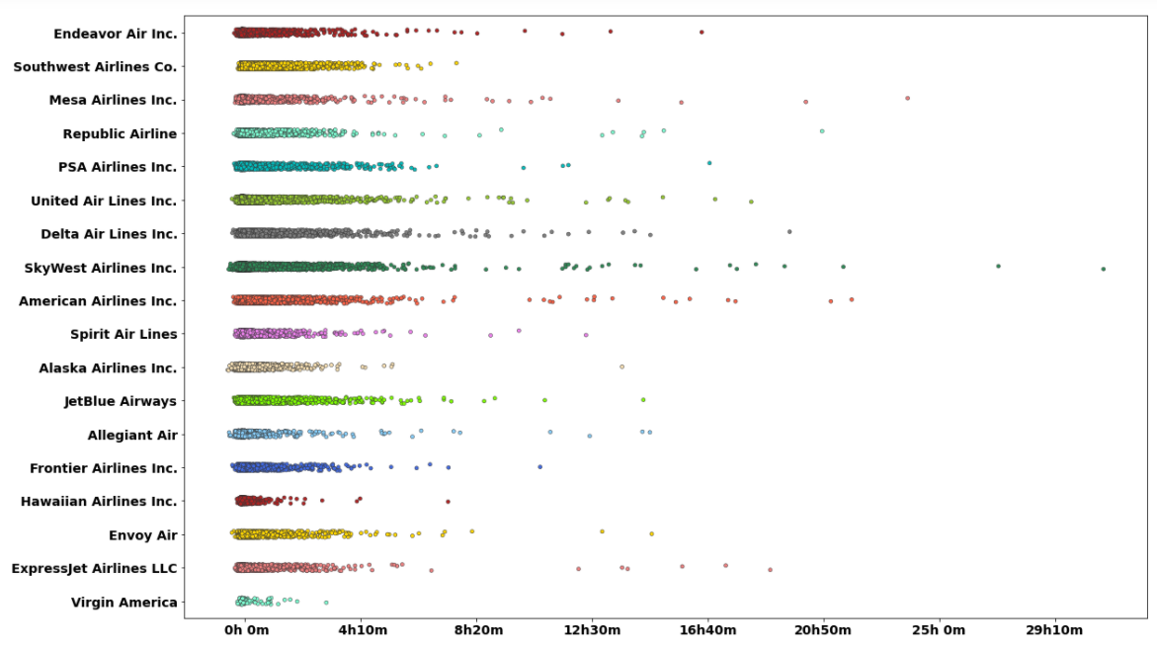

Slide 11
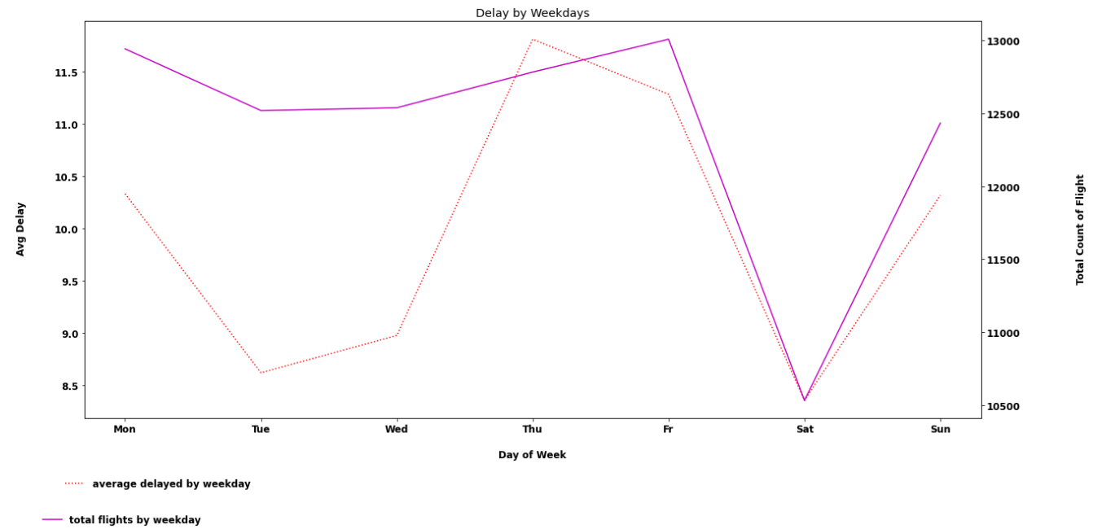

Slide 13
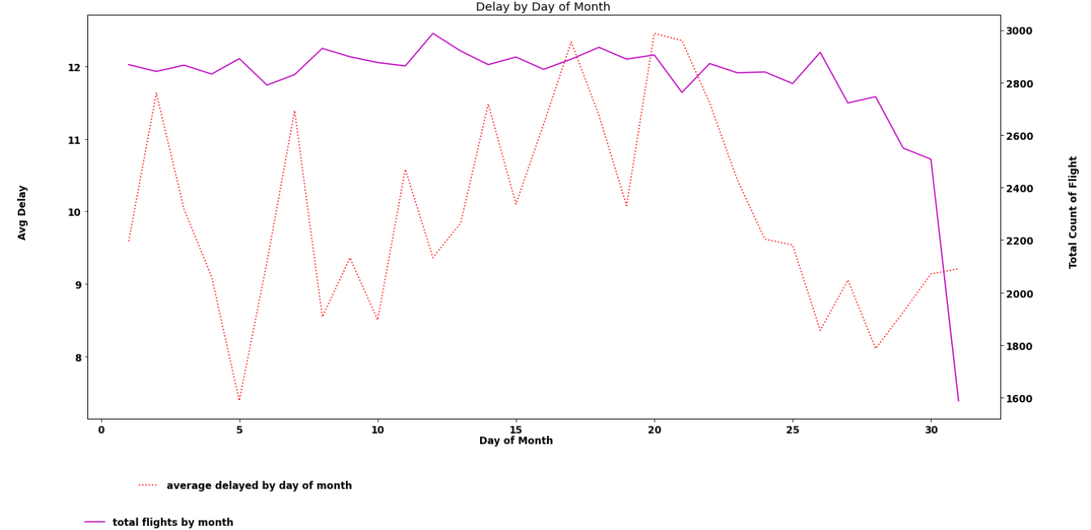

Slide 14
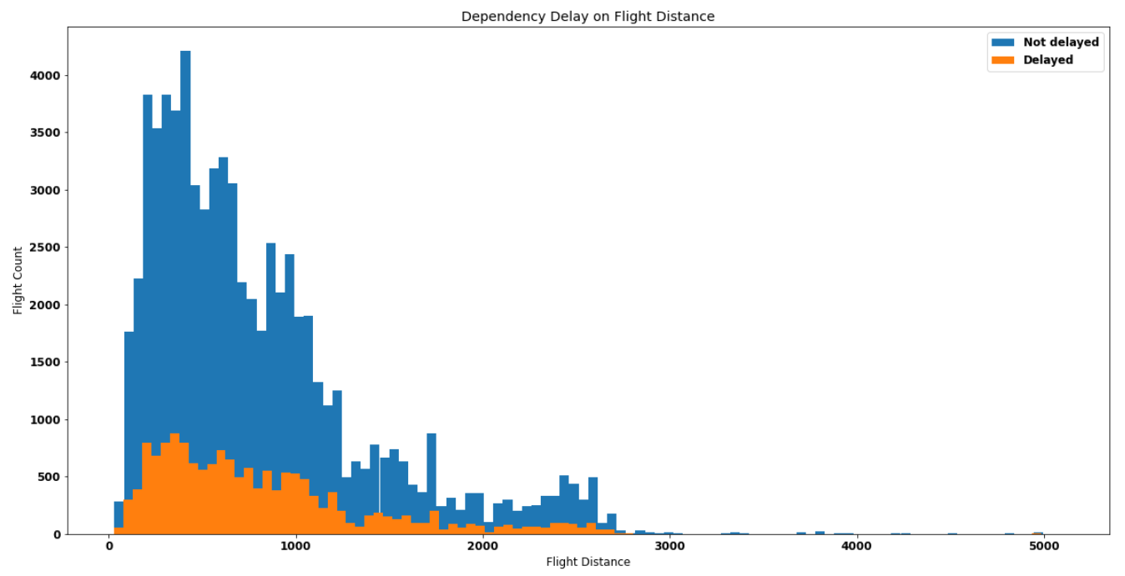

Slide 15
04.
Feature Engineering

Slide 16
Feature Engineering
One Hot Encoder
Selecting Features
Polynomial Feature
Dummify Destination City(‘object’)
Feature Selection based on domain knowledge the information available before departure
Polynomial feature on best 10 feature importance to improve model performance

Slide 17
05.
Model Performance

Slide 18
Model Performance
Model | Train Score | Test Score | Recall | ROC-AUC | Best Params

Slide 19
Best Features

Slide 20
OUR SERVICES
Mercury
Venus
Mars
Saturn
Neptune
Jupiter
Mercury is the closest planet to the Sun
Venus has a beautiful name, but it’s terribly hot
Despite being red, Mars is actually cold
Saturn is a gas giant with several rings
Neptune is the farthest planet from the Sun
It’s the biggest planet in
the Solar System

Slide 21
BEST SELLERS
Jupiter
Venus
Saturn
80%
90%
75%
It’s the biggest planet in the Solar System
Venus is the second planet from the Sun
Saturn is a gas giant with several rings

Slide 22
AWESOME WORDS

Slide 23
CUSTOMER TESTIMONIALS
Helena James
John Patterson
“Mercury is the closest
planet to the Sun and the
smallest one in the Solar
System—it’s only a bit
larger than the Moon”
“Despite being red, Mars is
a cold place, not hot. The
planet is full of iron oxide
dust, which gives the
planet its reddish cast”

Slide 24
OUR STRENGTHS
Loyalty
Efficiency
Reliability
Commitment
Neptune is the farthest planet from the Sun. It’s really cold there
Despite being red, Mars is a very cold place. It’s full of iron oxide dust
Mercury is the closest planet to the Sun and also the smallest one
Jupiter is a gas giant and the biggest planet in the Solar System

Slide 25
CUSTOMER PROFILE
Gender
Occupation
Age
Jupiter is the biggest planet
Mercury is the smallest planet
Despite being red, Mars is cold
Men
Women
70%
75%
25%
25 - 35
20%
36 - 45
10%
21-30
46 - 55
31-50

Slide 26
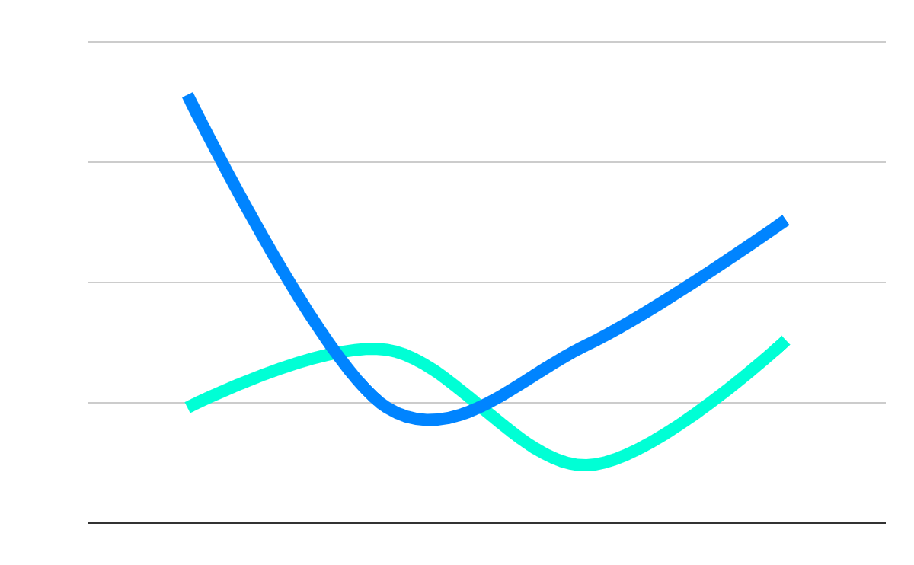
OUR GROWTH
20,000
Expected income for next year
100
New employees next year
1990
2000
2010
2020
Follow the link in the graph to modify its data and then paste the new one here. For more info, click here

Slide 27
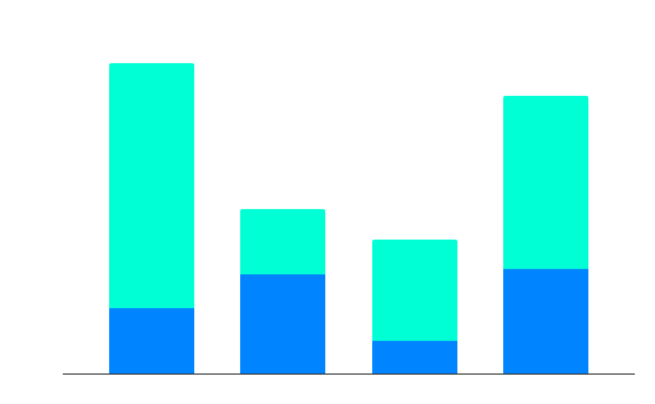
OUR NUMBERS
25%
Sales
Budget
80%
People
Mercury
Jupiter
50%
Market
50%
Efficiency
1990
2000
2010
2020
$28.87
30 days
40 shops
77 units
Avg. price per unit
Avg. days on market
Retailers
Remaining inventory
Follow the link in the graph to modify its data and then paste the new one here. For more info, click here

Slide 28
5,504,300
Big numbers catch your audience’s attention

Slide 29

MULTIMEDIA
You can replace the image on the screen with your own work
Or you can replace the image on the screen with another image
Just right-click on it and select “Replace image”

Slide 30
TABLE
 | Mercury | Mars | Jupiter
2018 | 647 | 984 | 268
2019 | 752 | 546 | 875
2020 | 455 | 856 | 340

Slide 31
9h 55m 23s
333,000
Is Jupiter's rotation period
Earths is the Sun’s mass

Slide 32

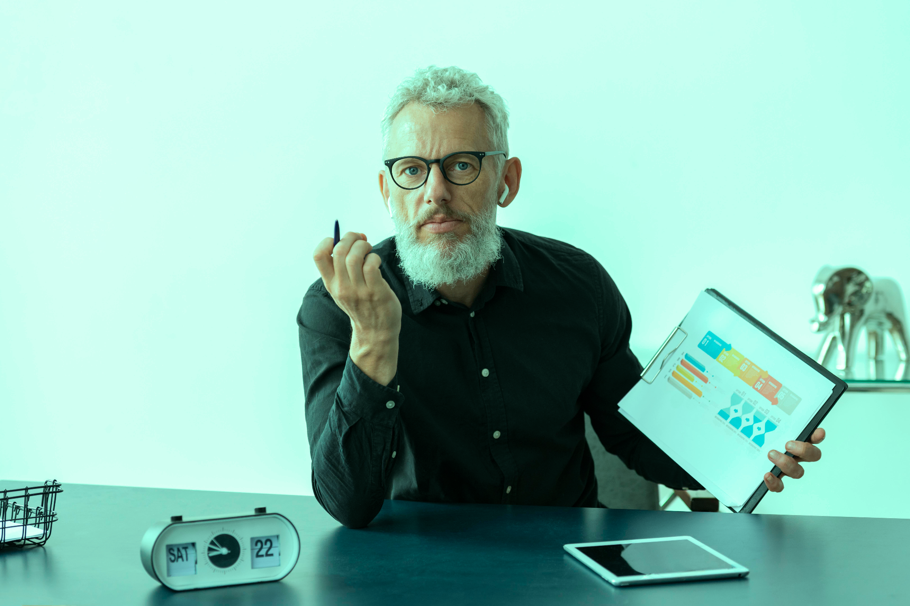
OUR TEAM
Jenna Doe
You can replace the image on the screen with your own
John James
You can replace the image on the screen with your own

Slide 33
FUTURE PROJECTS
Project 1
Project 3
Venus is the second planet from the Sun
Mercury is the closest planet to the Sun
01
02
03
04
Project 2
Project 4
Despite being red, Mars is a cold place
Jupiter is the biggest planet of them all

Slide 34
AWARDS
Venus
Mercury
Mars
Venus is the second planet from the Sun. It’s hot there
Mercury is the closest planet to the Sun and the smallest one
Despite being red, Mars is actually a very cold place

Slide 35
THANKS
Do you have any questions?
addyouremail@freepik.com +91 620 421 88 yourcompany.com
Please keep this slide for attribution

Slide 36
ALTERNATIVE RESOURCES

Slide 37
RESOURCES
Did you like the resources on this template? Get them for free at our other websites:
PHOTOS
Close-up man using smart touch screen server
Business infographics in hologram made by man
Older man at home showing graph on notepad with tablet on desk
Close up on person working on device
Senior woman teaching english lessons at home
Older man at home showing graph on notepad with tablet on desk
VECTORS
Technology social media posts set

Slide 38
Instructions for use (free users)
In order to use this template, you must credit Slidesgo by keeping the Thanks slide.
You are allowed to:
Modify this template.
Use it for both personal and commercial purposes.
You are not allowed to:
Sublicense, sell or rent any of Slidesgo Content (or a modified version of Slidesgo Content).
Distribute this Slidesgo Template (or a modified version of this Slidesgo Template) or include it in a database or in any other product or service that offers downloadable images, icons or presentations that may be subject to distribution or resale.
Use any of the elements that are part of this Slidesgo Template in an isolated and separated way from this Template.
Delete the “Thanks” or “Credits” slide.
Register any of the elements that are part of this template as a trademark or logo, or register it as a work in an intellectual property registry or similar.
For more information about editing slides, please read our FAQs or visit Slidesgo School:
https://slidesgo.com/faqs and https://slidesgo.com/slidesgo-school

Slide 39
Instructions for use (premium users)
As a Premium user, you can use this template without attributing Slidesgo or keeping the "Thanks" slide.
You are allowed to:
Modify this template.
Use it for both personal and commercial purposes.
Hide or delete the “Thanks” slide and the mention to Slidesgo in the credits.
Share this template in an editable format with people who are not part of your team.
You are not allowed to:
Sublicense, sell or rent this Slidesgo Template (or a modified version of this Slidesgo Template).
Distribute this Slidesgo Template (or a modified version of this Slidesgo Template) or include it in a database or in any other product or service that offers downloadable images, icons or presentations that may be subject to distribution or resale.
Use any of the elements that are part of this Slidesgo Template in an isolated and separated way from this Template.
Register any of the elements that are part of this template as a trademark or logo, or register it as a work in an intellectual property registry or similar.
For more information about editing slides, please read our FAQs or visit Slidesgo School:
https://slidesgo.com/faqs and https://slidesgo.com/slidesgo-school

Slide 40
Fonts & colors used
This presentation has been made using the following fonts:
Spartan
(https://fonts.google.com/specimen/Spartan)
Righteous
(https://fonts.google.com/specimen/Righteous)
#10092d
#0084ff
#00ffd5ff
#ffffffff

Slide 41





Storyset
Create your Story with our illustrated concepts. Choose the style you like the most, edit its colors, pick the background and layers you want to show and bring them to life with the animator panel! It will boost your presentation. Check out How it Works.
Pana
Amico
Bro
Rafiki
Cuate

Slide 42
Use our editable graphic resources...
You can easily resize these resources without losing quality. To change the color, just ungroup the resource and click on the object you want to change. Then, click on the paint bucket and select the color you want. Group the resource again when you’re done. You can also look for more infographics on Slidesgo.

Slide 45
JANUARY
FEBRUARY
MARCH
APRIL
MAY
JUNE
PHASE 1
Task 1
Task 2
PHASE 2
Task 1
Task 2
JANUARY
FEBRUARY
MARCH
APRIL
PHASE 1
Task 1
Task 2

Slide 48
...and our sets of editable icons
You can resize these icons without losing quality.
You can change the stroke and fill color; just select the icon and click on the paint bucket/pen.
In Google Slides, you can also use Flaticon’s extension, allowing you to customize and add even more icons.

Slide 49
Educational Icons
Medical Icons

Slide 50
Business Icons
Teamwork Icons

Slide 51
Help & Support Icons
Avatar Icons

Slide 52
Creative Process Icons
Performing Arts Icons

Slide 53
Nature Icons

Slide 54
SEO & Marketing Icons

Slide 55


